Slide 1
Instruction Formats
Department of Computer Science & Engineering
Pandit Deendayal Energy University, Gandhinagar

Slide 2
Introduction
In computer organization, instruction formats refer to the way instructions are encoded and represented in machine language. There are several types of instruction formats, including zero, one, two, and three-address instructions.
Each type of instruction format has its own advantages and disadvantages in terms of code size, execution time, and flexibility. Modern computer architectures typically use a combination of these formats to provide a balance between simplicity and power.

Slide 3
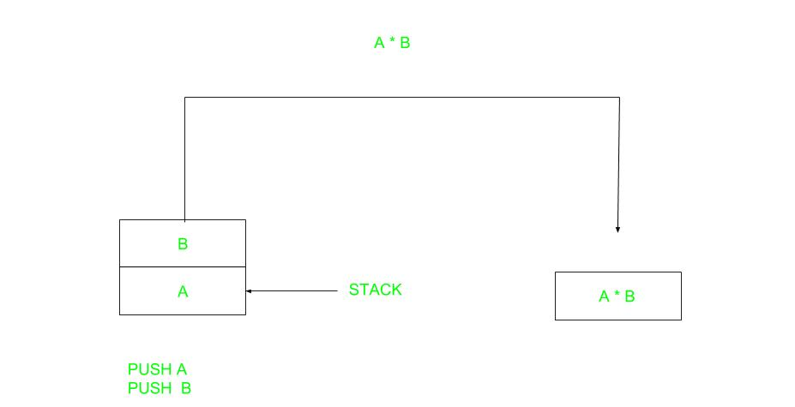
Zero Address Instructions
These instructions do not specify any operands or addresses. Instead, they operate on data stored in registers or memory locations implicitly defined by the instruction. For example, a zero-address instruction might simply add the contents of two registers together without specifying the register names.

Slide 4
Zero Address Instructions
Expression: X = (A+B)*(C+D) Postfixed : X = AB+CD+* TOP means top of stack M[X] is any memory location
PUSH A TOP = A
PUSH B TOP = B
ADD TOP = A+B
PUSH C TOP = C
PUSH D TOP = D
ADD TOP = C+D
MUL TOP = (C+D)*(A+B)
POP X M[X] = TOP

Slide 5

One Address Instructions
These instructions specify one operand or address, which typically refers to a memory location or register. The instruction operates on the contents of that operand, and the result may be stored in the same or a different location. For example, a one-address instruction might load the contents of a memory location into a register.
This uses an implied ACCUMULATOR register for data manipulation. One operand is in the accumulator and the other is in the register or memory location. Implied means that the CPU already knows that one operand is in the accumulator so there is no need to specify it.

Slide 6
One Address Instructions
Expression: X = (A+B)*(C+D)
AC is accumulator
M[] is any memory location
M[T] is temporary location
LOAD A AC = M[A]
ADD B AC = AC + M[B]
STORE T M[T] = AC
LOAD C AC = M[C]
ADD D AC = AC + M[D]
MUL T AC = AC * M[T]
STORE X M[X] = AC

Slide 7
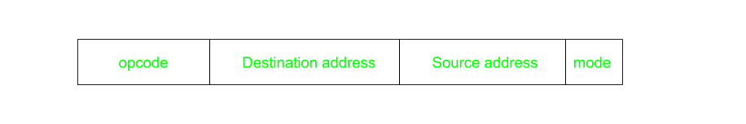
Two Address Instructions
These instructions specify two operands or addresses, which may be memory locations or registers. The instruction operates on the contents of both operands, and the result may be stored in the same or a different location. For example, a two-address instruction might add the contents of two registers together and store the result in one of the registers.
This is common in commercial computers. Here two addresses can be specified in the instruction. Unlike earlier in one address instruction, the result was stored in the accumulator, here the result can be stored at different locations rather than just accumulators, but require more number of bit to represent the address.

Slide 8
Two Address Instructions
Expression: X = (A+B)*(C+D)
R1, R2 are registers
M[] is any memory location
MOV R1, A R1 = M[A]
ADD R1, B R1 = R1 + M[B]
MOV R2, C R2 = M[C]
ADD R2, D R2 = R2 + M[D]
MUL R1, R2 R1 = R1 * R2
MOV X, R1 M[X] = R1

Slide 9
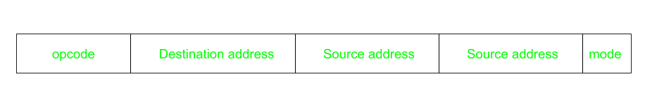
Three Address Instructions
These instructions specify three operands or addresses, which may be memory locations or registers. The instruction operates on the contents of all three operands, and the result may be stored in the same or a different location.
For example, a three-address instruction might multiply the contents of two registers together and add the contents of a third register, storing the result in a fourth register.
This has three address fields to specify a register or a memory location.
Programs created are much short in size but number of bits per instruction increases. These instructions make the creation of the program much easier but it does not mean that program will run much faster because now instructions only contain more information but each micro-operation (changing the content of the register, loading address in the address bus etc.) will be performed in one cycle only.

Slide 10
Three Address Instructions
Expression: X = (A+B)*(C+D)
R1, R2 are registers
M[] is any memory location
ADD R1, A, B R1 = M[A] + M[B]
ADD R2, C, D R2 = M[C] + M[D]
MUL X, R1, R2 M[X] = R1 * R2

Slide 11
Advantages
Zero-address instructions
They are simple and can be executed quickly since they do not require any operand fetching or addressing. They also take up less memory space.
One-address instructions
They allow for a wide range of addressing modes, making them more flexible than zero-address instructions. They also require less memory space than two or three-address instructions.
Two-address instructions
They allow for more complex operations and can be more efficient than one-address instructions since they allow for two operands to be processed in a single instruction. They also allow for a wide range of addressing modes.
Three-address instructions
They allow for even more complex operations and can be more efficient than two-address instructions since they allow for three operands to be processed in a single instruction. They also allow for a wide range of addressing modes.

Slide 12
Disadvantages
Zero-address instructions
They can be limited in their functionality and do not allow for much flexibility in terms of addressing modes or operand types.
One-address instructions
They can be slower to execute since they require operand fetching and addressing.
Two-address instructions
They require more memory space than one-address instructions and can be slower to execute since they require operand fetching and addressing.
Three-address instructions
They require even more memory space than two-address instructions and can be slower to execute since they require operand fetching and addressing.

